Slide 1
CloudSAMS
Introduction of transmitting
TSA Student Data file via CloudSAMS

Slide 2
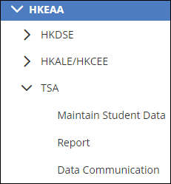
HKEAA Module Structure
HKEAA
HKDSE
HKALE/HKCEE
TSA
Maintain Student Data
Report
Data Communication

Slide 3
Data Transmission between CloudSAMS and BCA System
CloudSAMS
HKEAA’s BCA system
Student
Relevant Student Data
Security
Access Right
TSA
CDS

Slide 4
Overview of Workflow
Workflow to submit TSA Student Data file via CDS in CloudSAMS:
1. CDS > Incoming Message
Decrypt the parameter file “TSA parameter file for primary school”.
2. HKEAA > TSA > Data Communication > Process Incoming Data
Import parameter file “TSA parameter file for primary school”.
3. HKEAA > TSA > Maintain Student Data
Maintain and save the student data.

Slide 5
Overview of Workflow
4. HKEAA > TSA > Data Communication > Prepare Outgoing Data
Prepare the TSA Student Data file and check the report. If there is no problem, confirm the TSA Student Data file”.
5. CDS > Outgoing Message > Maintain Message
Encrypt and send the TSA Student Data file.

Slide 6
Step 1
CDS > Incoming Message

Slide 7
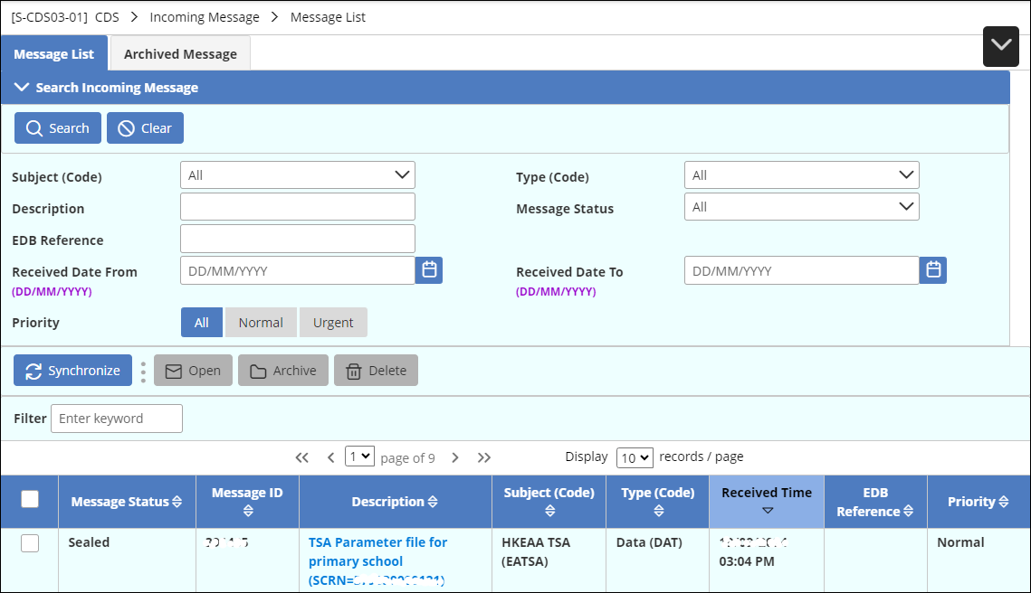
Decrypt TSA Parameter at CDS module
CDS > Incoming Message > Message List
1. Click the TSA parameter file.

Slide 8
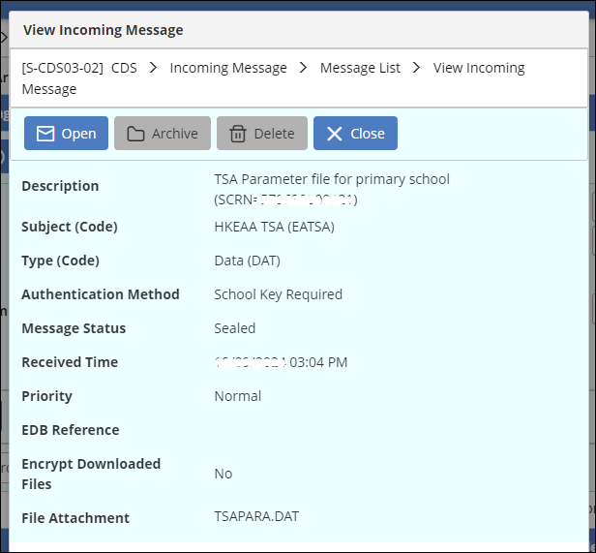
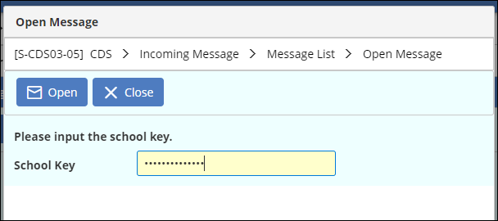
Decrypt TSA Parameter at CDS module
3. Input “School Key”
Then press “Open” button
2. Press “Open” button

Slide 9
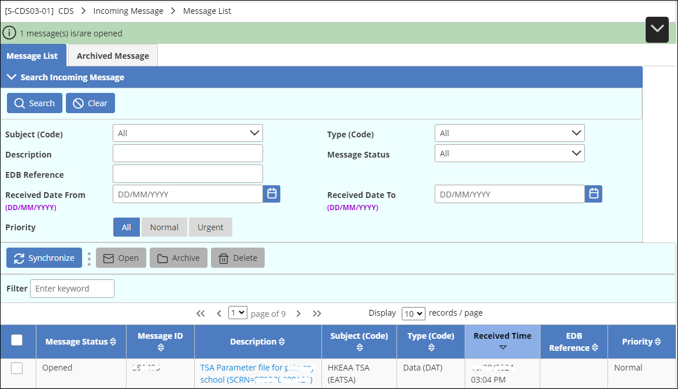
Decrypt TSA Parameter at CDS module
4. Message is decrypted.

Slide 10
Step 2
HKEAA > TSA > Data Communication > Process Incoming Data

Slide 11
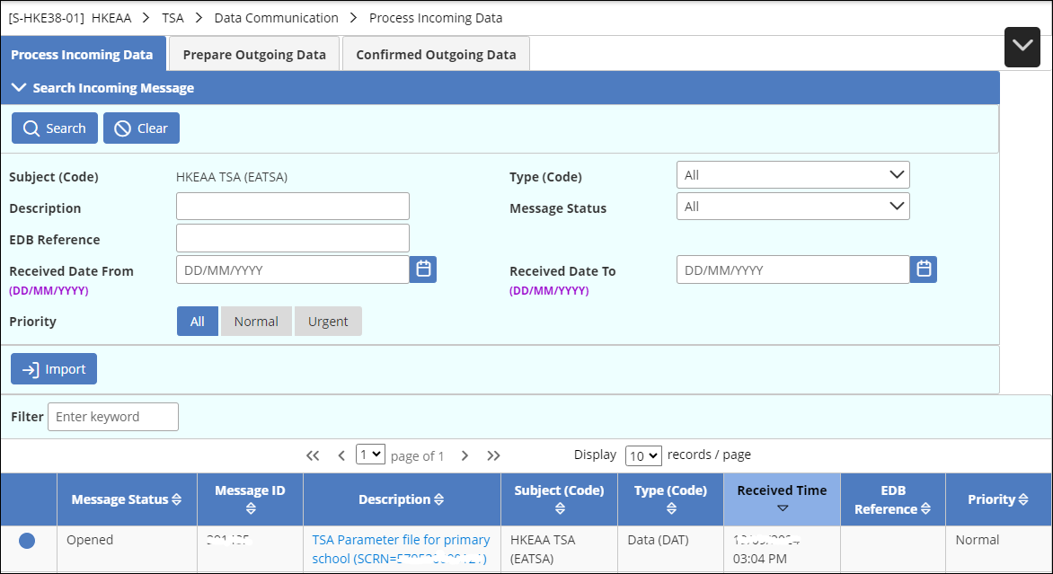
Import the decrypted parameter
HKEAA > TSA > Data Communication > Process Incoming Data
2. Press “Import”.
1. Choose parameter file.

Slide 12
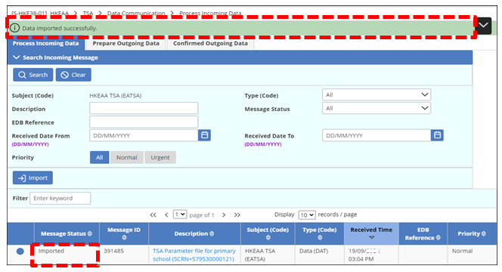
Import the decrypted parameter
HKEAA > TSA > Data Communication > Process Incoming Data
3. The message status will change to “Imported”. Relevant message is shown at the top of the screen.

Slide 13
Import Parameter File
Each parameter file is imported for one school level and school session.
In case a school is a through-train school with “AM” and “PM” sessions operated, user has to import three parameter files in total. (i.e. Parameter file for Primary – A.M section , Parameter file for Primary– P.M. section, and Parameter file for Secondary )

Slide 14
Step 3
HKEAA > TSA > Maintain Student Data

Slide 15
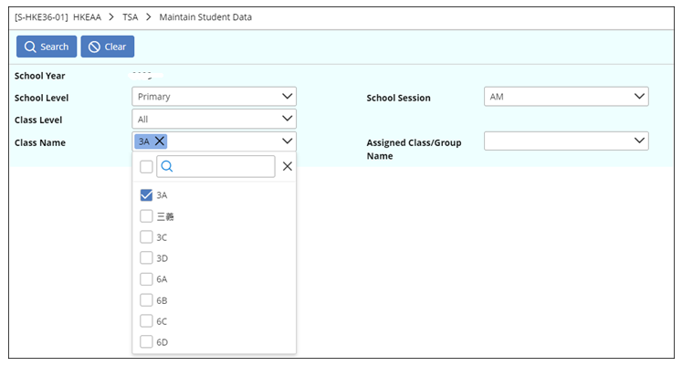
Maintain Student Data
HKEAA > TSA > Maintain Student Data
2. Press “Search” button.
1. Select search criteria.

Slide 16
Maintain Student Data
Data that match search criteria are shown
3a. Default Value = Original Class Name & Class Number

Slide 17
Maintain Student Data
3b. Modified data → Change into RED
3c. Whole Entry = RED = Newly admitted student

Slide 18
Maintain Student Data
6. Display of relevant system message.
5. Press “Save” button.
4. Select students for record saving.

Slide 19
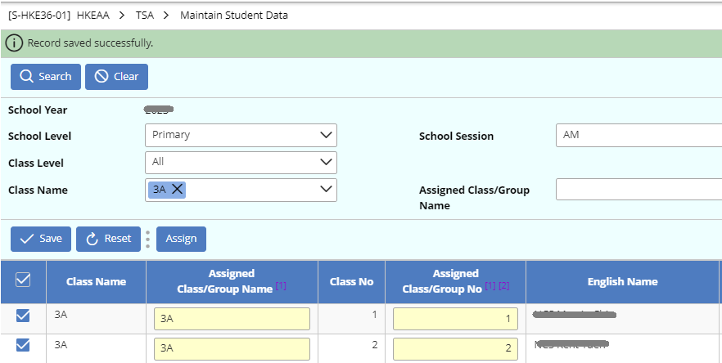
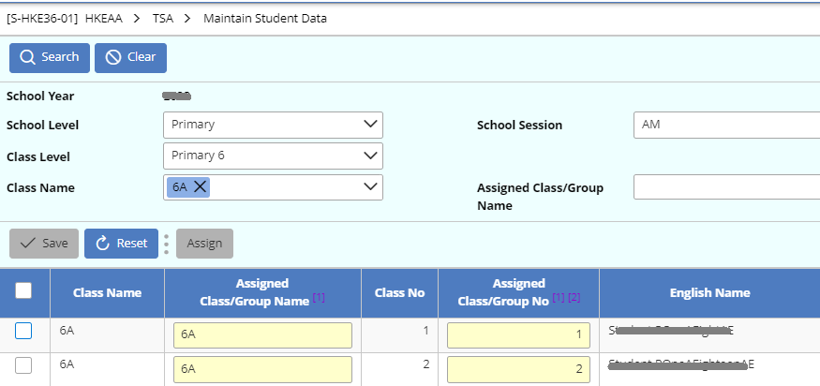
Maintain Student Data: Reminder (1)
Note:
Always save the edited data before starting a new search

Slide 20
Maintain Student Data: Reminder (2)
Note:
If Chinese character (e.g. 三義) is used for Class Name, user should modify Assigned Class/Group Name into English (e.g. 3A).

Slide 21
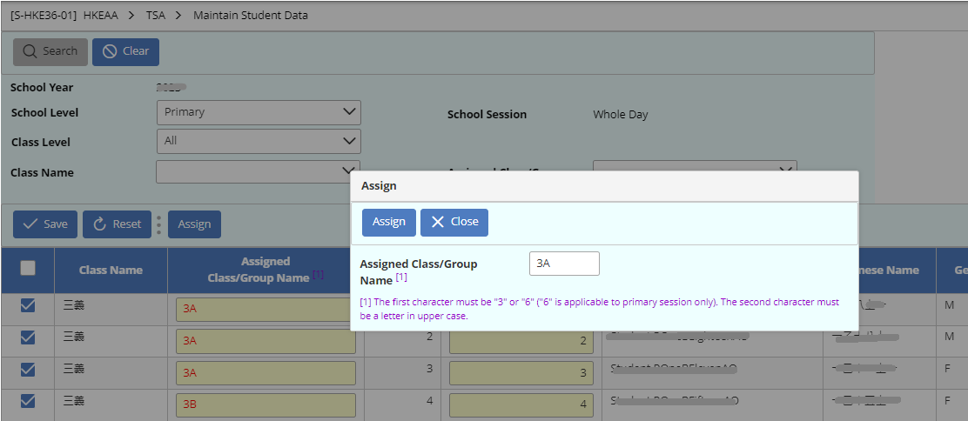
Maintain Student Data: How to change Class/Group by batch
ii. Press “Assign” button.
iii. Input a class/group name.
iv. Press “Assign” again.
v. Press “Save” button.
i. Select students(s).

Slide 22
STEP 4
HKEAA > TSA > Data Communication > Prepare Outgoing Data

Slide 23
Prepare Outgoing Data
HKEAA > TSA > Data Communication > Prepare Outgoing Data
2. Press “Prepare” button.
1. Check “TSA Student Data”.

Slide 24
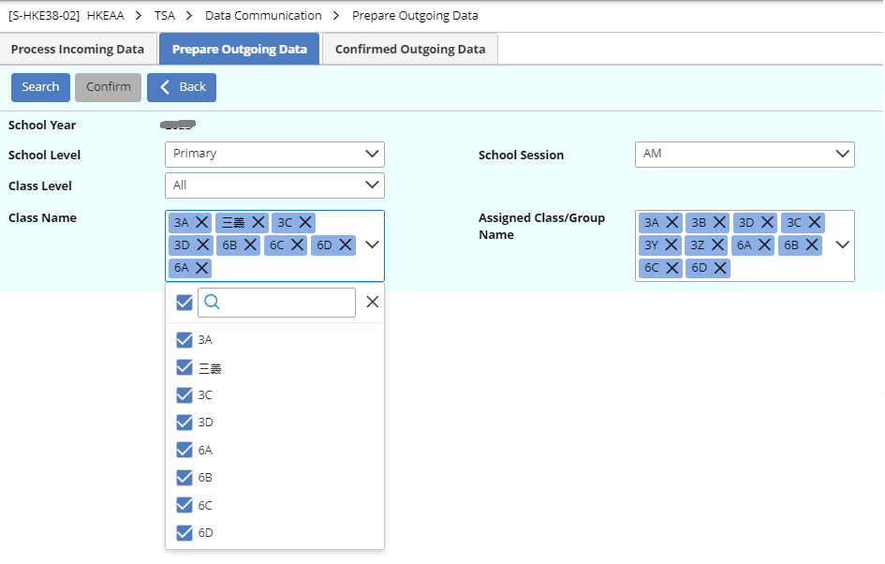
Prepare Outgoing Data
4. Press “Search” button.
3. Select search criteria.

Slide 25
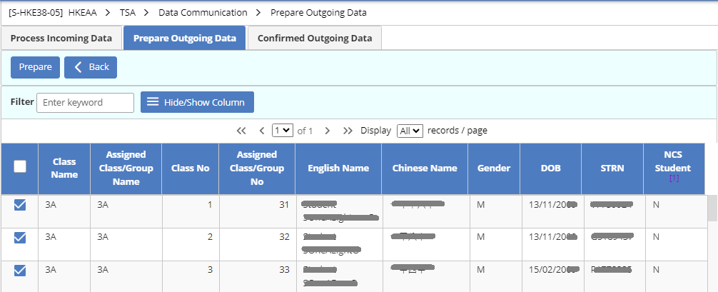
Prepare Outgoing Data
6. Press “Prepared”
5. Select student(s).

Slide 26
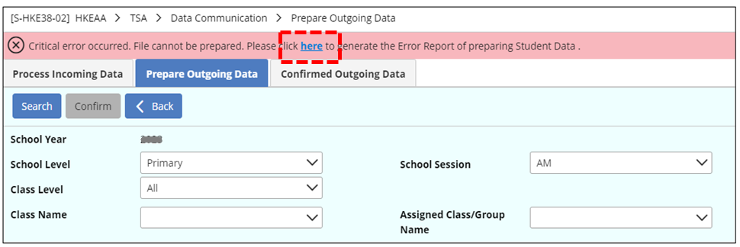
Prepare Outgoing Data
7. In case error(s) is/are detected, please rectify errors according to the Error Report.

Slide 27
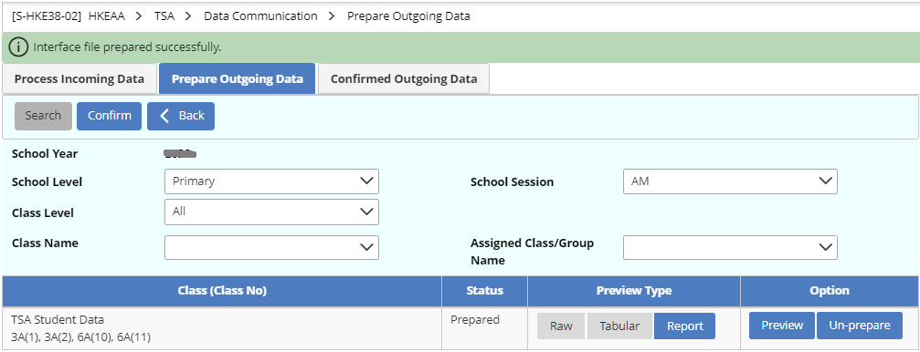
Prepare Outgoing Data
8. If there is no error, a TSA student data file will be prepared for preview. Select a type of report under “Preview Type” first, then press “Preview” under “Option”.

Slide 28
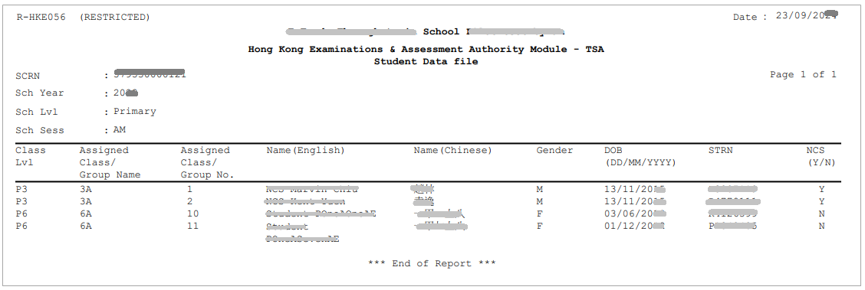
Prepare Outgoing Data
Report Sample

Slide 29
Prepare Outgoing Data
9. After viewing the report:
→ If user needs to modify the TSA student data, press “Un-prepare” button.
→ If no modification is needed, press “Confirm”.

Slide 30
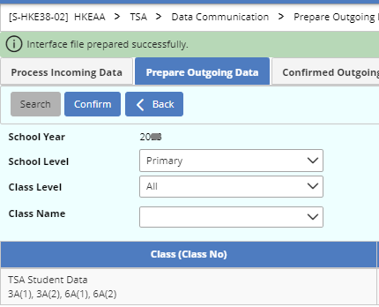
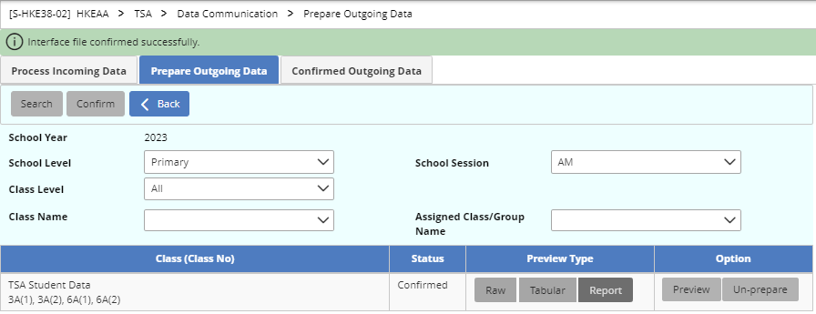
Prepare Outgoing Data
10. After pressing “Confirm” button and the data file is confirmed successfully, a system message will be shown at the top of the system and “Confirm” button will turn dimmed.

Slide 31
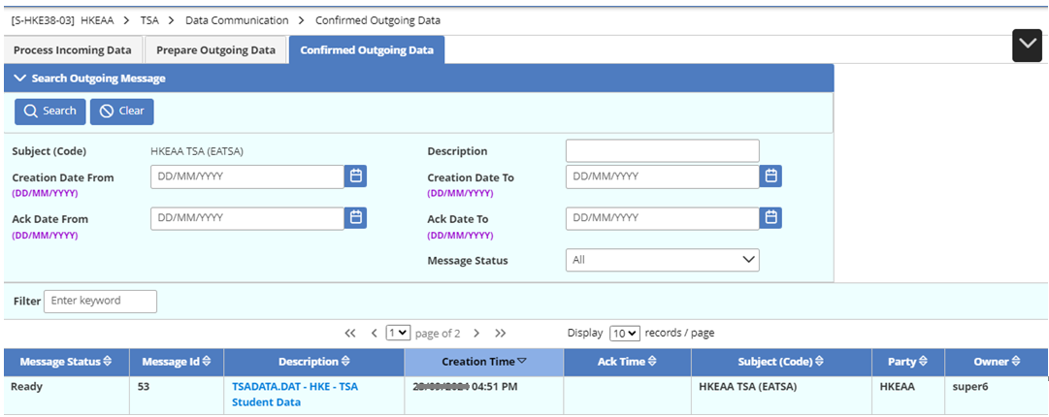
Confirmed Outgoing Data
HKEAA > TSA > Data Communication > Confirmed Outgoing Data
11. The student data file is ready to be sent via CDS.

Slide 32
Step 5
CDS > Outgoing Message > Maintain Message

Slide 33
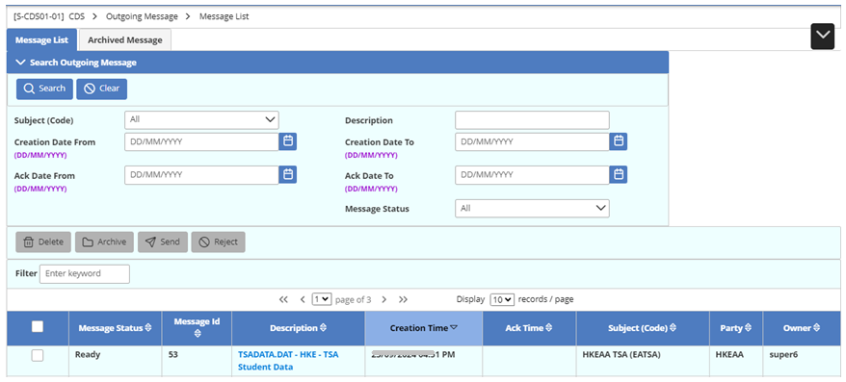
View and Send Outgoing Message
CDS > Outgoing Message > Message List
1. Click the TSA Student Data file.

Slide 34
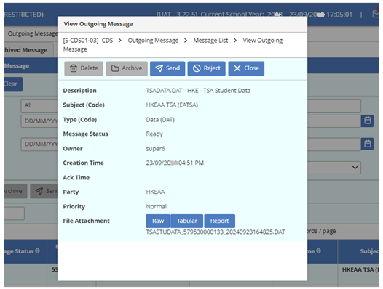
View and Send Outgoing Message
2. Press “Send” button.
3. In the new dialogue box, enter School Key.
4. Press “Send” button.

Slide 35
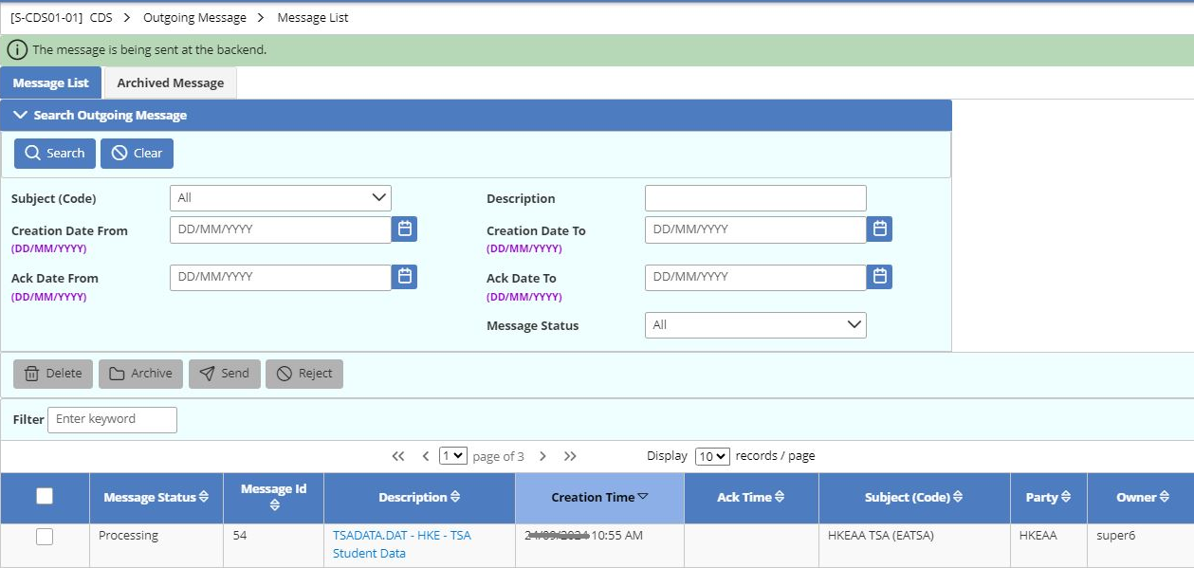
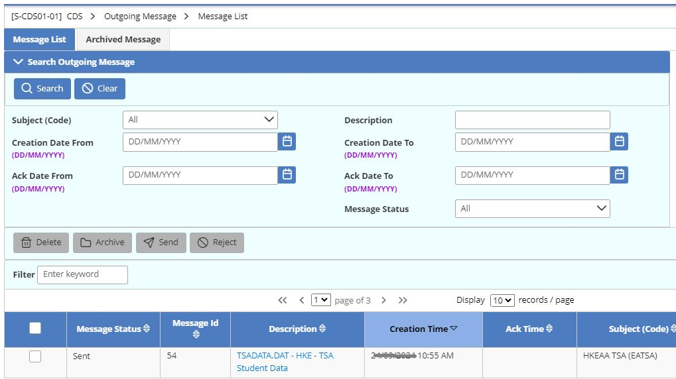
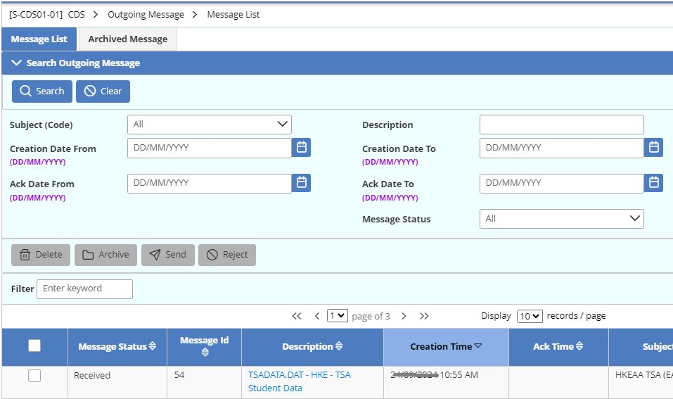
Send Outgoing Message
5.Sucessful message is seen at the top of the screen. Message status will change from “Processing” to “Received”.

Slide 36
TSA RePORT

Slide 37
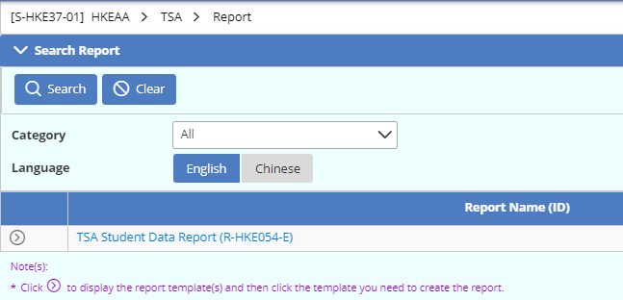
TSA Report
HKEAA > TSA > Report
2. Press “Search” button.
1. Choose language.
3. Choose “Built-in Template”

Slide 38
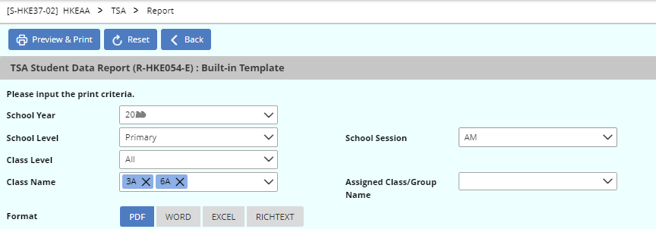
TSA Report
5. Press “Preview & Print” button.
4. Choose print criteria.
Note:
The information on report is based on the latest confirmed and sent TSA data file.

Slide 39
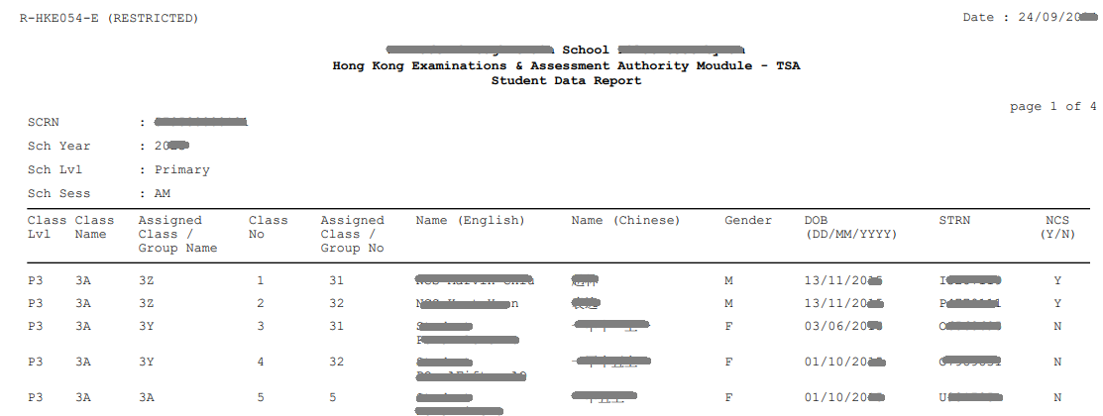
Report Sample

Slide 40
END

